Slide 1
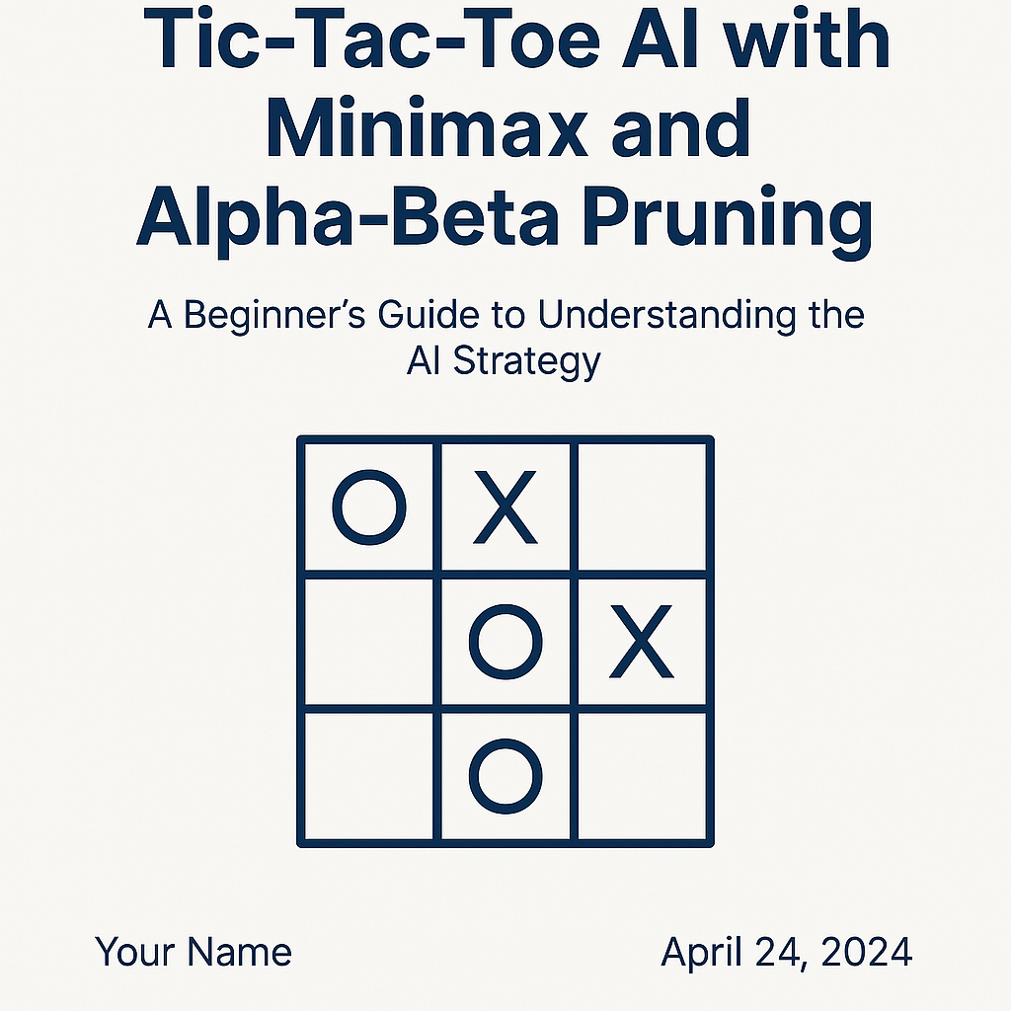
Tic-Tac-Toe AI with Minimax and Alpha-Beta Pruning
A Beginner's Guide to Understanding the AI Strategy
TECHNO_GEEKS
Kiran Yadav (202410116100102) Khushi Kumari (202410116100101) Dolly Prajapati (202410116100069) Gulsan Kumari (202410116100078)

Slide 2
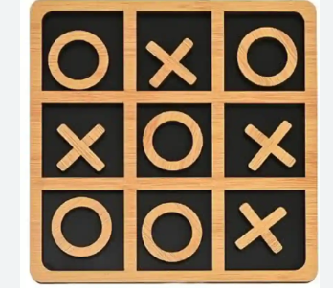
Introduction to Tic-Tac-Toe
A simple two-player game played on a 3x3 grid.
Players take turns to place their marks (X or O).
The goal is to get three of your marks in a row (horizontally, vertically, or diagonally).

Slide 3
Game Objective
Player O (Human) goes first.
Player X (AI) plays second.
The goal for both players
The AI (X) needs to evaluate
The human player makes the opening move of the game.
The AI responds with calculated moves.
Either win or force a draw by blocking the opponent's winning moves.
Find the best move to win or minimize loss.

Slide 4




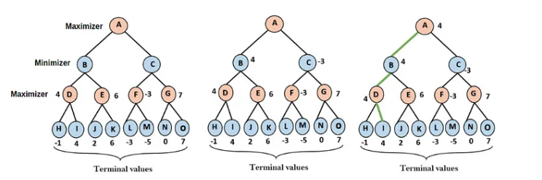

What is the Minimax Algorithm?
Recursive Algorithm
Optimal Play
Minimize Loss
Minimizing Player (AI)
Minimax is a recursive algorithm used to decide the optimal move in games.
The algorithm assumes both players play optimally (best moves).
The goal is to minimize the possible loss for the worst-case scenario.
Tries to minimize the score (AI plays to block human).
Maximizing Player (Human)
Tries to minimize the score (human plays to block AI).

Slide 5
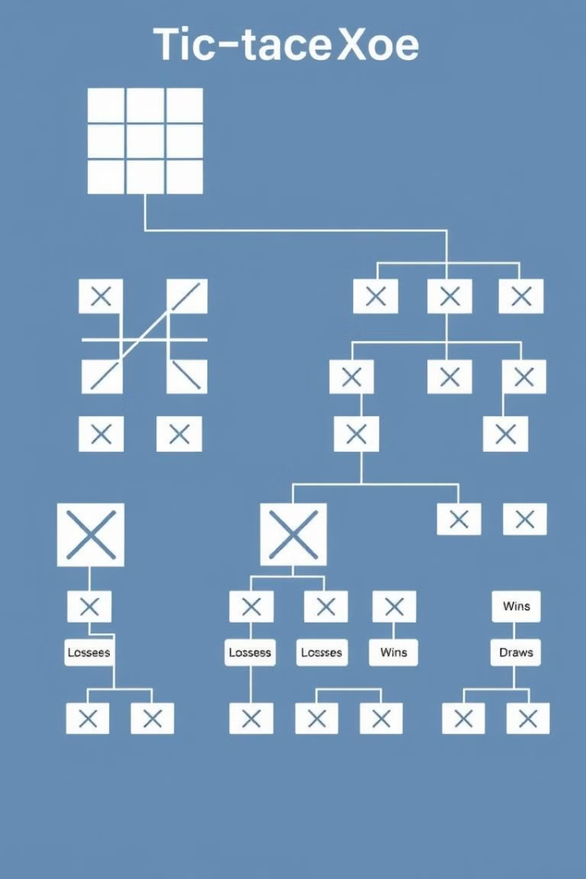
How Minimax Algorithm Works
Generate all possible future game states (game tree).
Create a tree of all possible moves and counter-moves.
Evaluate the terminal states (win, lose, draw).
Assign scores to end game positions.
Maximize Human score and minimize AI’s score
Work backwards through the tree, alternating between max and min levels.
Choose the move that leads to the best possible outcome.
Select the highest-scoring move at the current position.

Slide 6
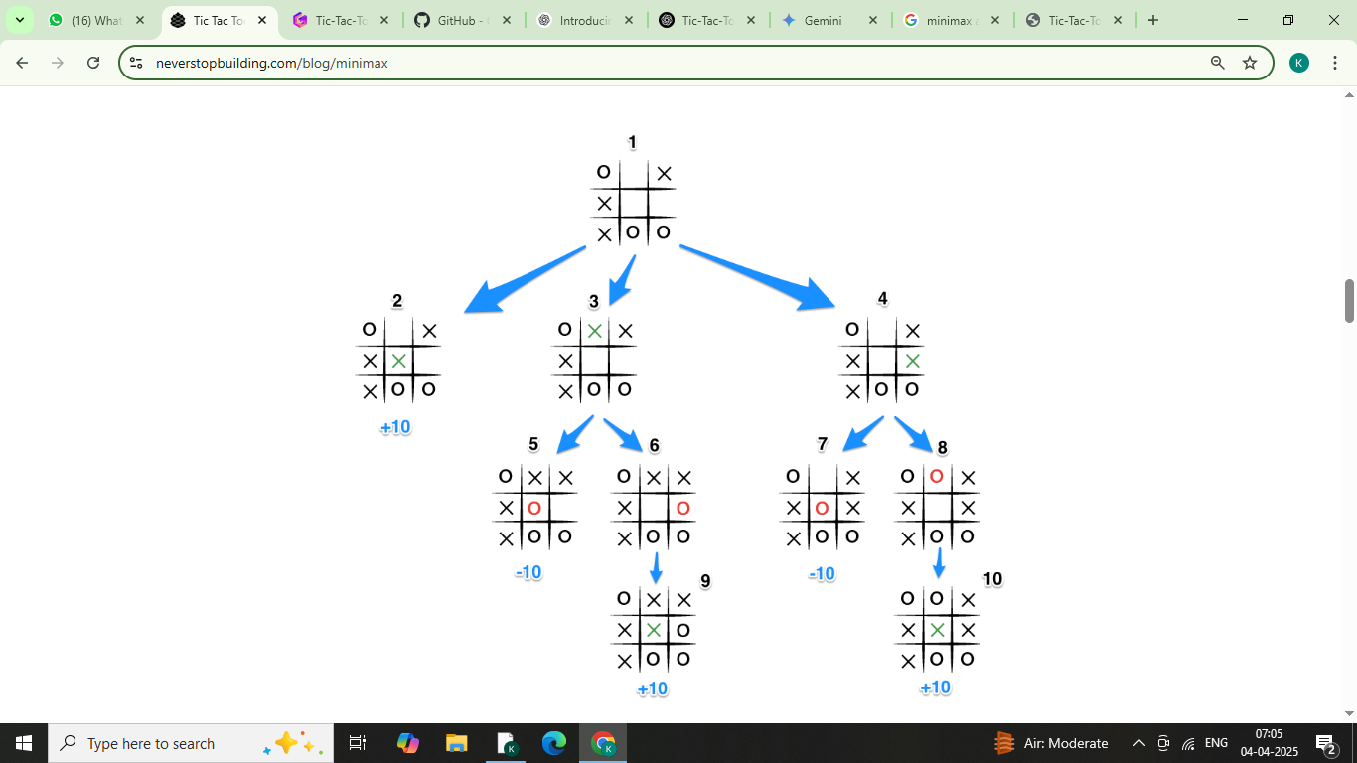
It's X's turn in state 1. X generates the states 2, 3, and 4 and calls minimax on those states.
State 2 pushes the score of +10 to state 1's score list, because the game is in an end state.
State 3 and 4 are not in end states, so 3 generates states 5 and 6 and calls minimax on them, while state 4 generates states 7 and 8 and calls minimax on them.
State 5 pushes a score of -10 onto state 3's score list, while the same happens for state 7 which pushes a score of -10 onto state 4's score list.
State 6 and 8 generate the only available moves, which are end states, and so both of them add the score of +10 to the move lists of states 3 and 4.
Because it is O's turn in both state 3 and 4, O will seek to find the minimum score, and given the choice between -10 and +10, both states 3 and 4 will yield -10.
Finally the score list for states 2, 3, and 4 are populated with +10, -10 and -10 respectively, and state 1 seeking to maximize the score will chose the winning move with score +10, state 2.

Slide 7
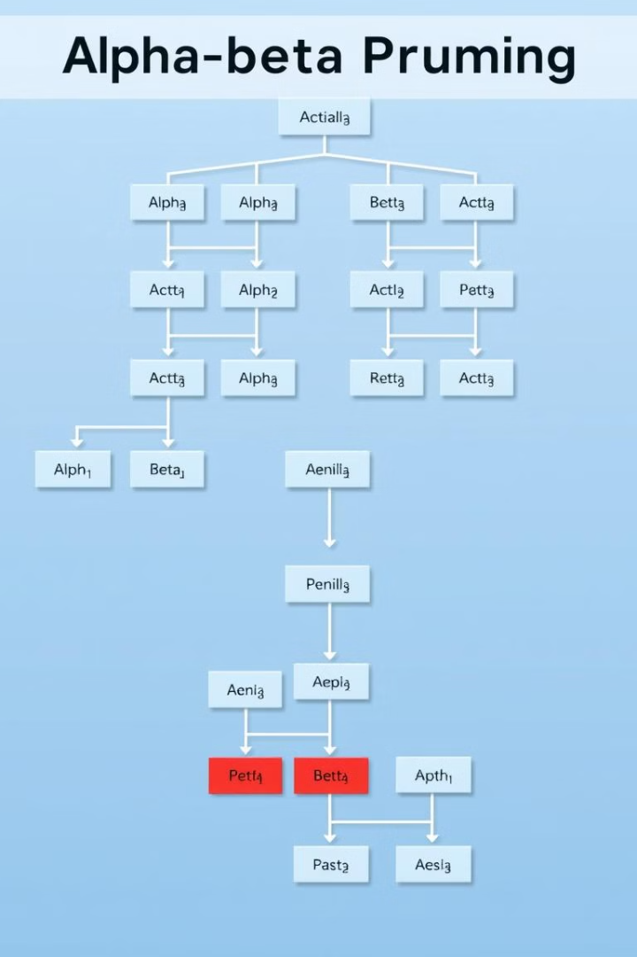
What is Alpha-Beta Pruning?
Optimization Technique
Alpha-Beta Pruning is an optimization technique for Minimax.
Alpha Value
Best value found so far along the path of the Maximizing player.
Beta Value
Best value found so far along the path of the Minimizing player.
Branch Pruning
Prunes branches that cannot possibly influence the final decision.

Slide 8
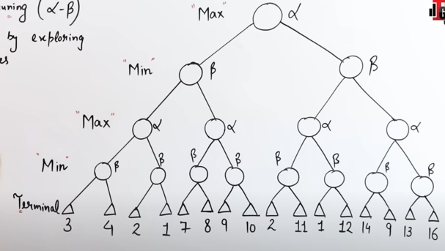
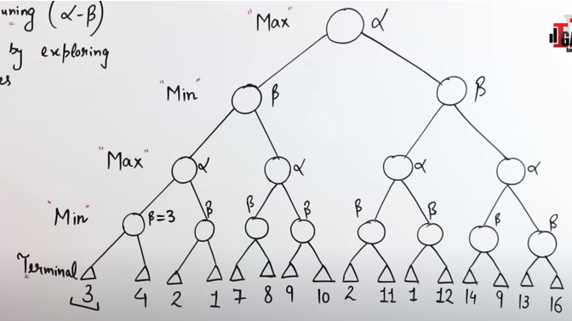
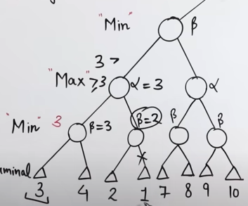
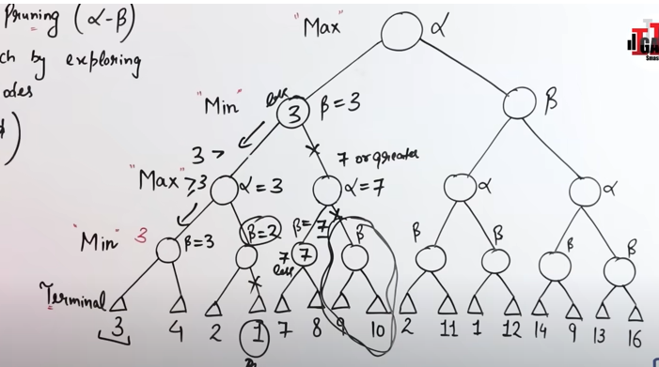
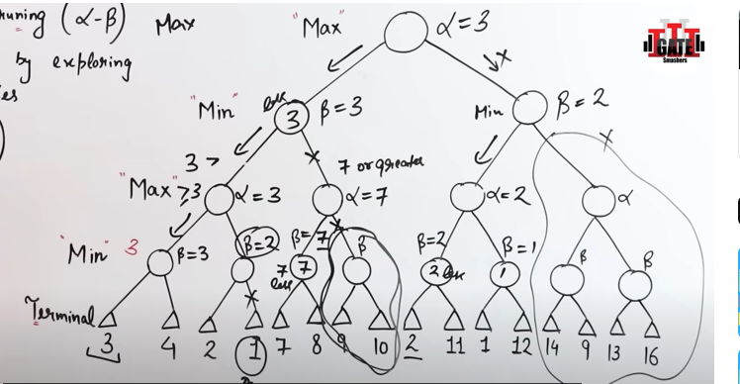

Slide 9
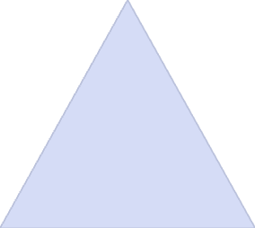

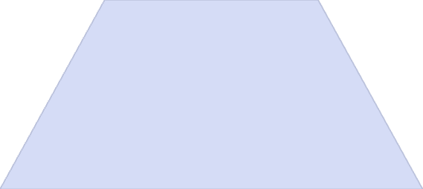

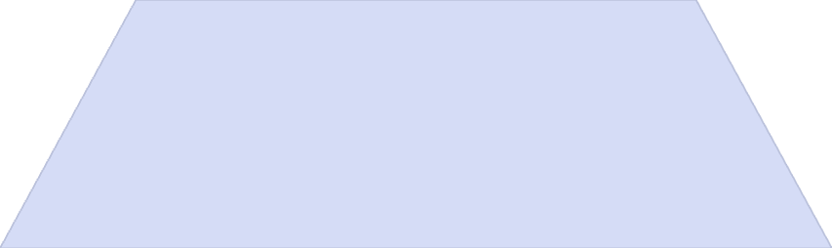

How Alpha-Beta Pruning Improves Efficiency
Pruning Branches
During the recursive search, if a move cannot improve the outcome, the branch is "pruned."
Reduced Calculations
It reduces the number of recursive calls and speeds up the decision-making process.
Efficiency Example
If AI knows that no matter what, the score will be less than the current score (Beta), it doesn't need to explore that path.

Slide 10





Game Flow:
Human (O) makes the first move.
Player places an O on the empty board.
AI (X) evaluates all possible moves using Minimax and Alpha-Beta Pruning.
Human chooses the best move based on available options.
Algorithm calculates optimal response.
Player responds to AI's move.
The AI picks the optimal move, minimizing the human's chances of winning.
Repeat until there is a winner or draw.
Algorithm recalculates based on new board state.
Game continues with alternating turns.

Slide 11
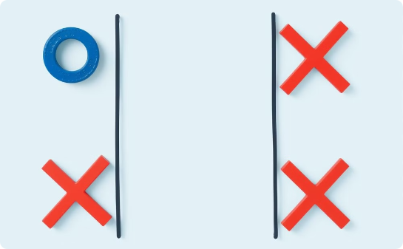
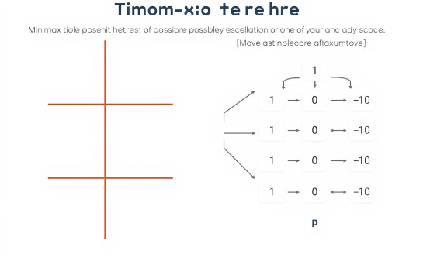
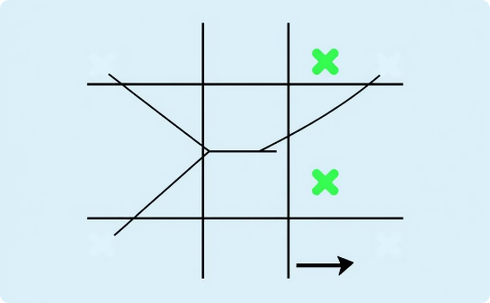
Walkthrough
Initial Board State
Evaluation Process
Pruning and Selection
Given the board after the human's first move: X | O | X O | | | | O
The AI will evaluate all possible moves after the human (O) places the first mark.
Use Alpha-Beta Pruning to speed up the search.
AI selects the best move and updates the board.
Apply Minimax recursively to explore the outcomes.

Slide 12
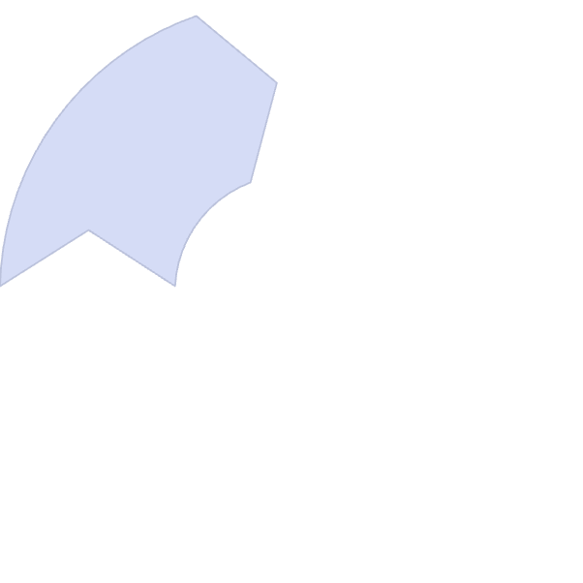
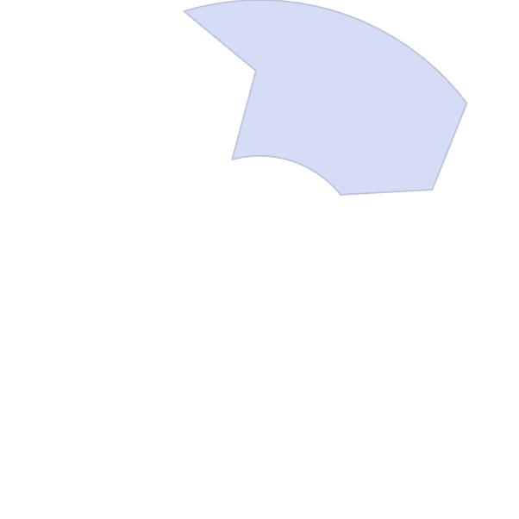
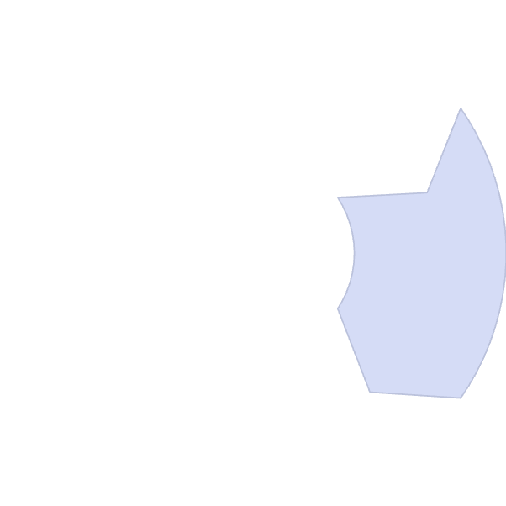
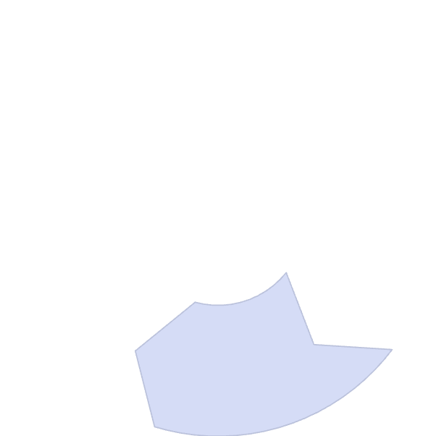
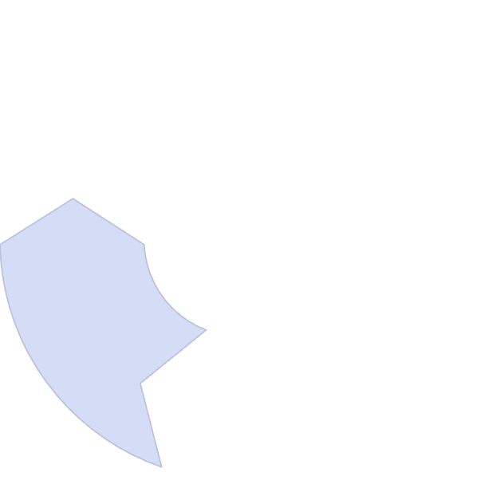





Code Walkthrough
is_winner
print_board
Checks if a player has won.
Displays the current board.
minimax
Recursive function that evaluates the board.
play
The main function that controls the game flow between human and AI.
best_move
Finds the best move using Minimax and Alpha-Beta Pruning.

Slide 13
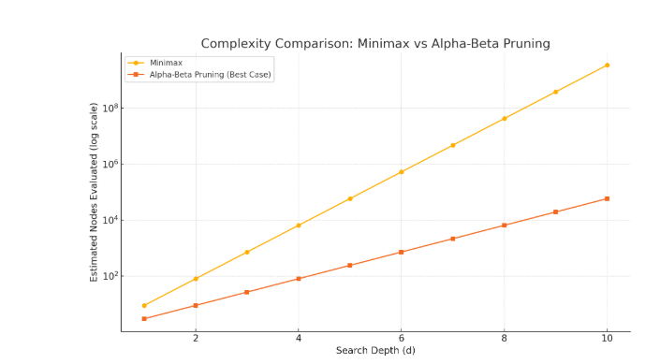
Time Complexity: Minimax vs Alpha-Beta Pruning
Algorithm | Best Case | Worst Case | Explanation
Minimax | O(b^d) | O(b^d) | Explores all possible nodes to a certain depth.
Alpha-Beta Pruning | O(b^d/2)) | O(b^d) | Skips branches that won’t affect the final decision. Much faster with good move ordering.

Slide 14
THANK YOU

